Slide 1
Predicting the Success of a Recipe
What can we conclude from the ratings in Epicurious.com?
Notes:
My presentation is about the prediction of the success of a recipe. What can we conclude from the ratings in Epicurious.com?

Slide 2
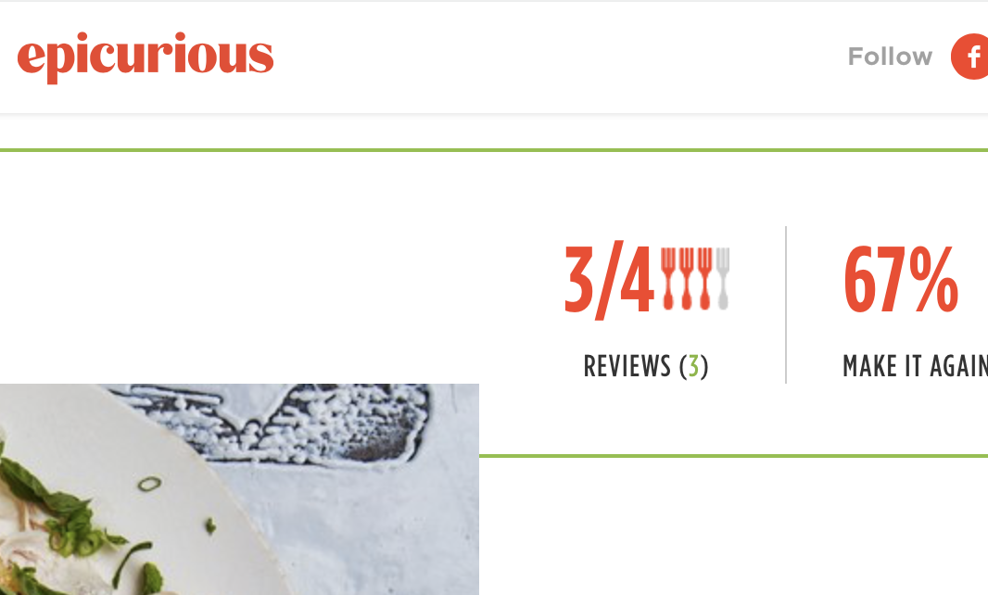
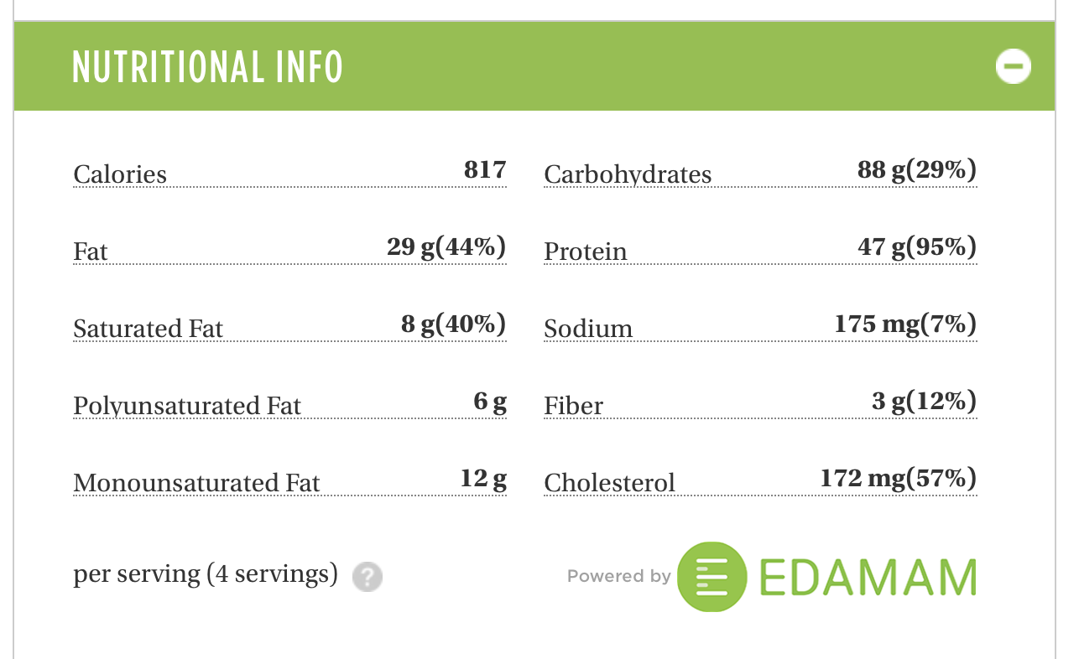
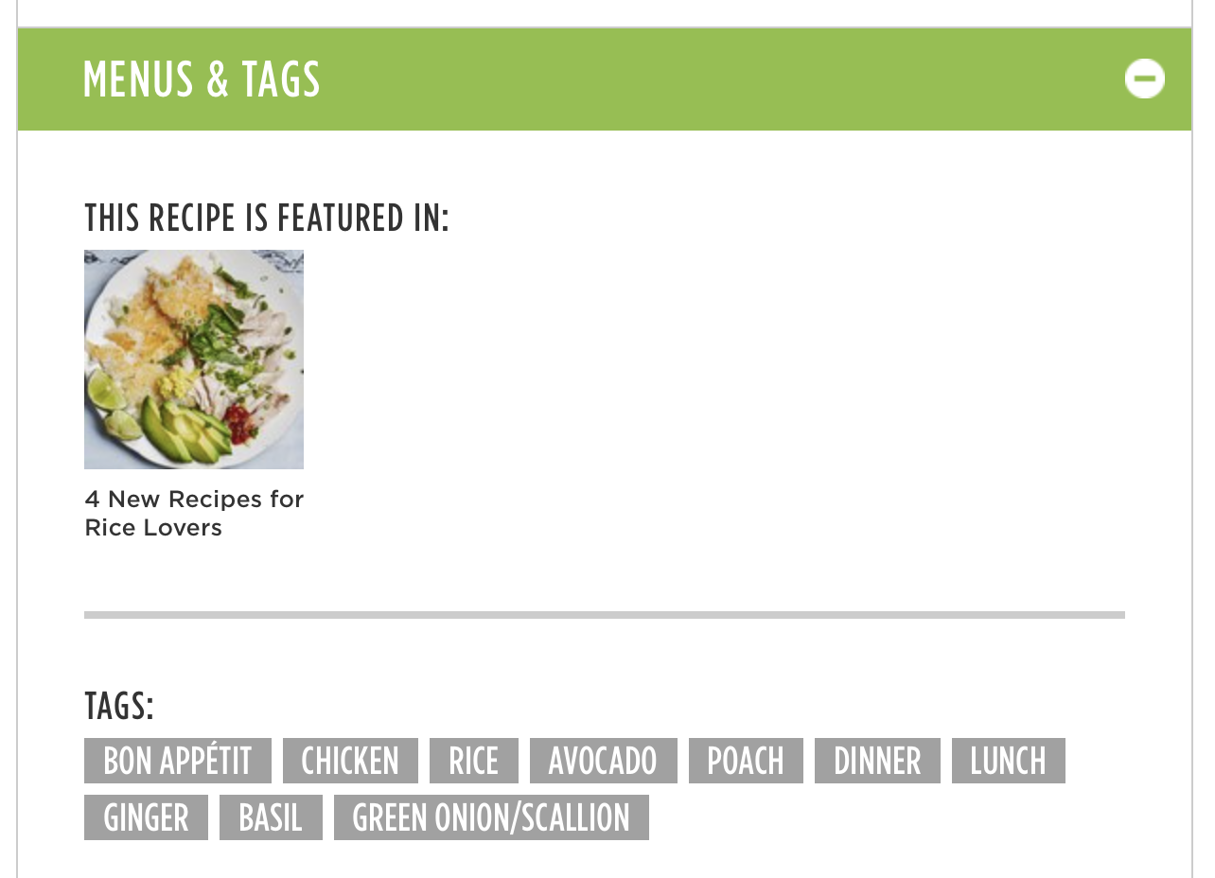
Web Scraping and Data Cleaning
+7000 Recipes (lunch and dinner) scraped from Epicurious.com
Removed missing data and outliers
~1000 Recipes
Notes:
For this analysis, I scraped more than seven thousand recipes, filtered by lunch and dinner meals, and after removing the missing data and outliers, it resulted in one thousand observations. As features, I used types of data: Nutricion data, which includes, calories, protein etc and the main ingredients of each recipe.

Slide 3
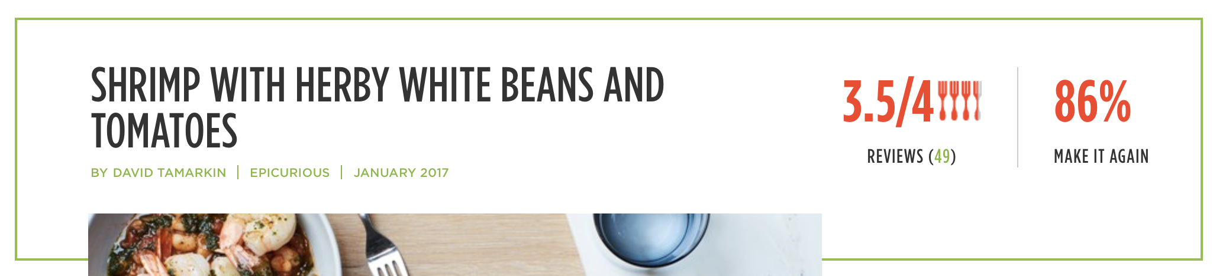
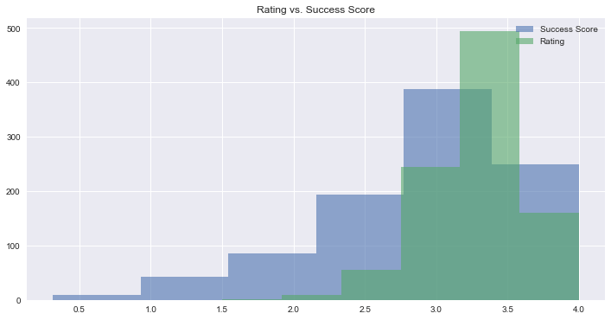
Choosing the Target Variable
Success Score = Rating * ”Make it again”
Notes:
For this analysis, I chose to measure the Success score by the rating combined with the percentage of people that said that would make that recipe again. It seems more realistic than using purely ratings.

Slide 4
Choosing the Features
1. Nutrition Data
Calories
Protein
Cholesterol
Etc.
Independent Variables
2. Ingredients (dummy)
Notes:
For this analysis, I scraped more than seven thousand recipes, filtered by lunch and dinner meals, and after removing the missing data and outliers, it resulted in one thousand observations. As features, I used types of data: Nutricion data, which includes, calories, protein etc and the main ingredients of each recipe.

Slide 5
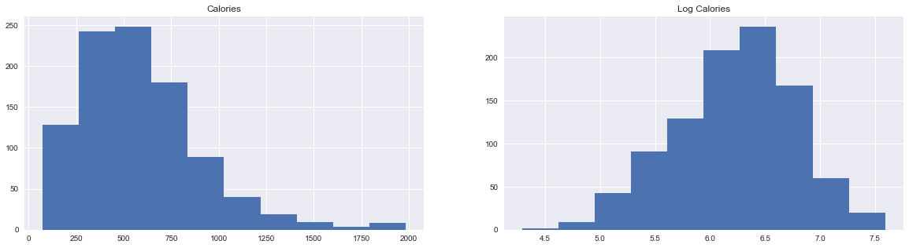
Data Wrangling
Log transformation in Nutrition Data
Calories distribution
Log Calories distribution
Feature Selection for choosing Ingredients
Recursive Feature Elimination (sklearn.feature_selection)
Ranks the predictors based on their contribution to the model.
Selected 50 most important features
Notes:
All the nutrition data was right skewed, so I transformed them to log, so they had a better distribution. For the ingredients, since there were many, I used the Recursive Feature Elimination for choosing the 50 ingredients that are more important for the model.

Slide 6
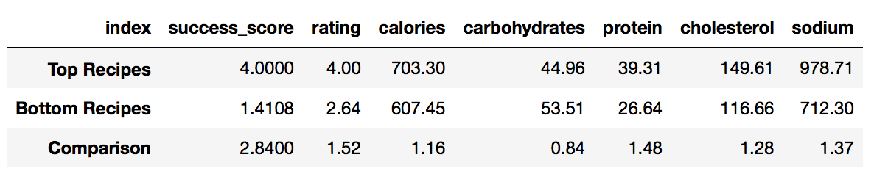
Preliminary Analysis
On average, the 100 best rated recipes have more calories, protein, cholesterol and sodium, and less carbohydrates than the 100 worse rated recipes.
Notes:
Before diving in the Exploratory analysis, I will make some preliminary analysis. I selected the 100 best and worse rated recipes and calculated the mean of the nutrition data.

Slide 7
Preliminary Analysis
Source: Article “What A Global Flavor Map Can Tell Us About How We Pair Foods (Nature.com)
The success of a recipe is a result of the combination of flavors and preparation methods

Slide 8
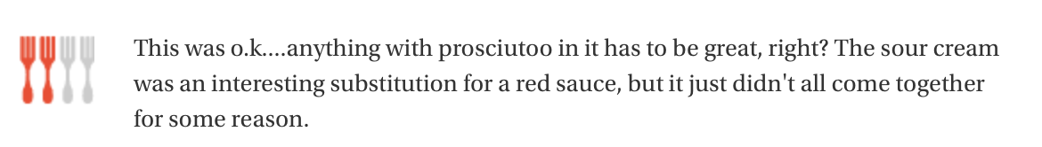

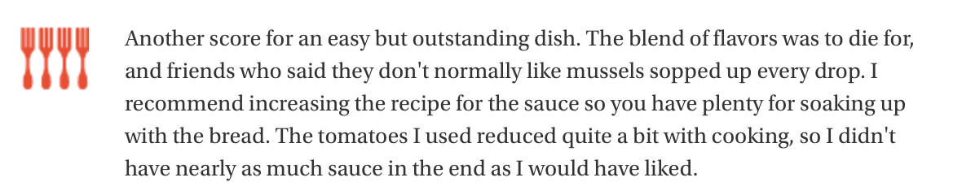
Preliminary Analysis
Reviews could help the analysis

Slide 9
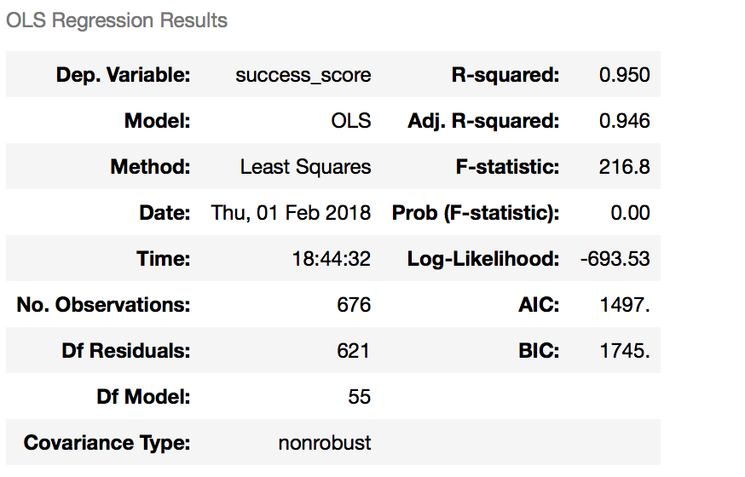
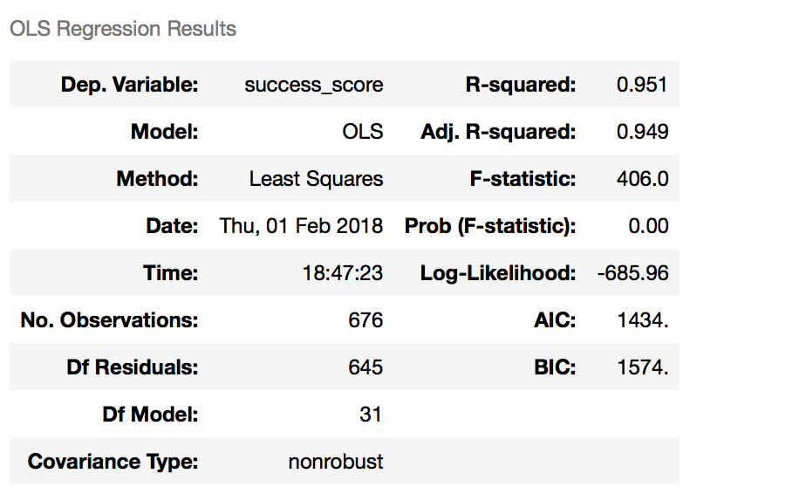
Exploratory Data Analysis Linear Regression
OLS Regression on training set (70% of data) beginning with the selected features.
Removed features when p-value high
MSE: 0.589
MSE: 0.576

Slide 10
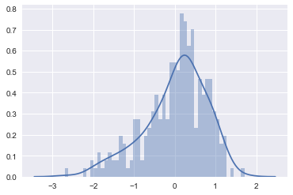
Exploratory Data Analysis Results
Residuals Distribution

Slide 11
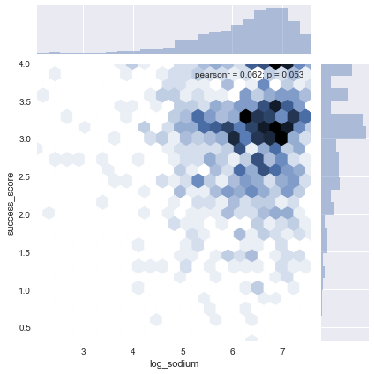
Exploratory Data Analysis Results
1% increase in log_sodium, the success score increases 0.13
1% increase in log_calories, the success score increases 0.56

Slide 12
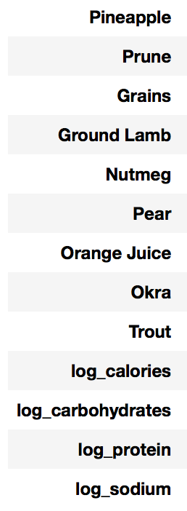
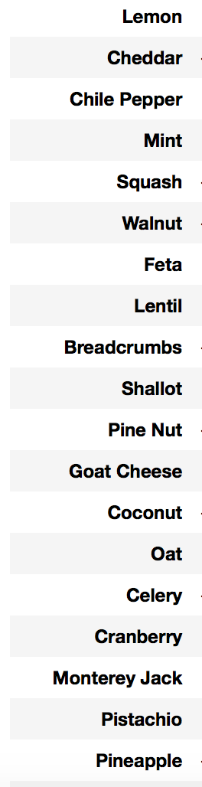
Exploratory Data Analysis
Features selected are mostly not main ingredients, but flavor additions to the recipes

Slide 13
Final Thoughts
Conclusions
People prefer more caloric and salty meal
“Fancy” ingredients may increase (or decrease) the rating
Main ingredients can not be individually analyzed in a recipe
Next Steps
Use a classification method
Extract proportions of ingredients
Use NLP for analyzing the reviews

